Slide 1


Pure Metals and Alloys
Jorge Andrés Rico Ramírez
1805074
Hora: M4-M6

Slide 2
What is a Pure Metal?
Pure metals are those metals that have not been alloyed with other metallic elements; commercially pure metals are 99% pure minimum.

Slide 3
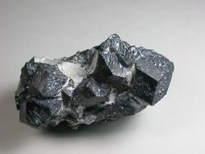
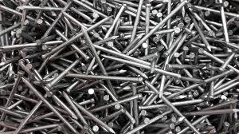
Examples:
Iron
Iron is a chemical element represented as Fe, it is a metal and is by mass the most common element on Earth, forming much of Earth's outer and inner core.

Slide 4
What is an Alloy?
An alloy is a homogeneous mixture of two or more elements, with one being a metal(in a solid form).

Slide 5

Examples
One example can be Gold, as used on jewellery is a mixture of Silver, and other metals.

Slide 6
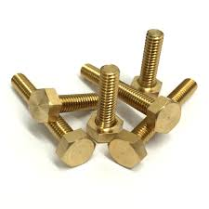

Brass
Brass is also an alloy, with copper and zinc as its main metals. Brass is usually used for door hinges and electrical plugs.

Slide 7
What´s the purpose of making Alloys?
The purpose of this mixture of metals is that, the alloy tends to have better qualities than the original metals.

Slide 8
Different fabrication process
Weldments: process of fusing together materials, they join metals, polymers and plastics, many common welding procedures involve an open electric arc or flame, the risk of burns, weldment is the main focus of Steel fabrication
Blacksmithing: in this fabrication process they create objects from wrought iron or steel by forging the metal, using tools to hammer, bend, and cut. The process consist of forging, bending, upsetting, punching, combining and finishing.

Slide 9
References:
Whitney, L. (2018, March 13). What Are the Differences Between an Alloy and a Pure Metal? Retrieved May 8, 2018, from https://sciencing.com/differences-between-alloy-pure-metal-10049555.html
Alloy. (2018, May 21). Retrieved May 21, 2018, from https://en.wikipedia.org/wiki/Alloy
What is an alloy? (n.d.). Retrieved May 8, 2018, from http://www.eschooltoday.com/science/elements-mixtures-compounds/what-is-an-alloy.html
Blacksmith. (n.d.). Retrieved May 8, 2018, from https://en.wikipedia.org/wiki/Blacksmith

